Slide 1

DB Apps Introduction
Intro to ADO.NET
SoftUni Team
Technical Trainers
Software University
http://softuni.bg

Slide 2
Table of Contents
Data Access Models
ADO.NET Architecture
Accessing SQL Server from ADO.NET
SQL Injection

Slide 3
Have a Question?
sli.do
#CSharpDB

Slide 4

Data Access Models
Connecting to a DB through C#

Slide 5


Connected Model
Connected data access model
Applicable to an environment where the database is constantly available
ADO.NET
constantly open
connection
DB
DB
ADO.NET client
Database

Slide 6
Connected Model: Benefits and Drawbacks
Connected data access model (SqlClient)
Benefits:
Concurrency control is easier to maintain
Better chance to work with the most recent version of the data
Drawbacks:
Needs a constant reliable network
Problems when scalability is an issue

Slide 7
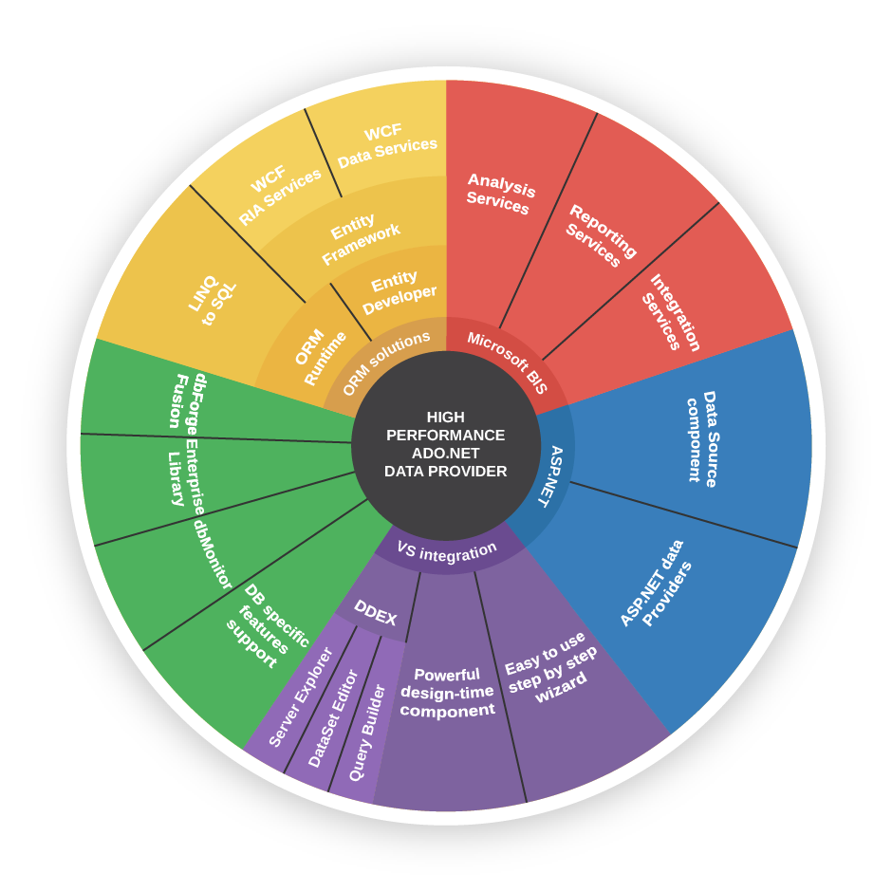
ADO.NET Architecture

Slide 8
What Is ADO.NET?
ADO.NET is a standard .NET class library for accessing databases, processing data and XML
Supports connected, disconnected and ORM data access models
Excellent integration with LINQ
Allows executing SQL in RDBMS systems
Allows accessing data in the ORM approach

Slide 9
Data Providers in ADO.NET
Data Providers are collections of classes that provide access to various databases
For different RDBMS systems different Data Providers are available
Several common objects are defined
Connection – to connect to the database
Command – to run an SQL command
DataReader – to retrieve data

Slide 10
Data Providers in ADO.NET (2)
Several standard ADO.NET Data Providers come as part of .NET Framework
SqlClient – accessing SQL Server
OleDB – accessing standard OLE DB data sources
Odbc – accessing standard ODBC data sources
Oracle – accessing Oracle databases
Third party Data Providers are available for:
MySQL, PostgreSQL, Interbase, DB2, SQLite
Other RDBMS systems and data sources
SQL Azure, Salesforce CRM, Amazon SimpleDB, …

Slide 11
SqlClient and ADO.NET Connected Model
Retrieving data in connected model
Open a connection (SqlConnection)
Execute command (SqlCommand)
Process the result set of the query by using a reader (SqlDataReader)
Close the reader
Close the connection
SqlDataReader
SqlParameter
SqlParameter
SqlCommand
SqlParameter
SqlConnection
Database

Slide 12
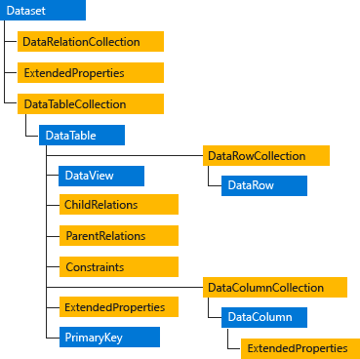
SqlClient and ADO.NET Disconnected Model
The DataSet object is central to supporting disconnected, distributed data scenarios with ADO.NET
DataSet is a memory-resident representation of data that provides a consistent relational programming model regardless of the data source

Slide 13
ORM Model
ORM data access model (Entity Framework Core)
Maps database tables to classes and objects
Objects can be automatically persisted in the database
Can operate in both connected and disconnected modes
OO
Programming
Language
ORM
Framework
Database

Slide 14
ORM Model – Benefits and Problems
ORM model benefits
Less code
Use objects with associations instead of tables and SQL
Integrated object query mechanism
ORM model drawbacks:
Less flexibility
SQL is automatically generated
Performance issues (sometimes)

Slide 15
ADO.NET: Entity Framework Core
Entity Framework Core is a generic ORM framework
Create entity data model mapping the database
Open an object context
Retrieve data with LINQ / modify the tables in the object context
Persist the object context changes into the DB
Connection is automatically managed

Slide 16

SQL Client Data Provider

Slide 17
SqlClient Data Provider
SqlConnection
Establish database connection to SQL Server
SqlCommand
Executes SQL commands on the SQL Server through an established connection
Could accept parameters (SQLParameter)
SqlDataReader
Retrieves data (record set) from SQL Server as a result of SQL query execution

Slide 18
The SqlConnection Class
SqlConnection establishes a connection to SQL Server database
Requires a valid connection string
Connection string example:
Connecting to SQL Server:
Data Source=(local)\SQLEXPRESS;Initial Catalog=SoftUni;Integrated Security=true;
SqlConnection con = new SqlConnection(
@"Server=.;
Database=SoftUni;
Integrated Security=true");
con.Open();

Slide 19
SqlConnection – Example
Creating and opening connection to SQL Server (database SoftUni)
SqlConnection dbCon = new SqlConnection(
"Server=.\\SQLEXPRESS; " +
"Database=SoftUni; " +
"Integrated Security=true");
dbCon.Open();
using (dbCon)
{
//TODO: Use the connection to execute SQL commands here …
}

Slide 20
DB Connection String
Database connection string
Defines the parameters needed to establish the connection to the database
Settings for SQL Server connections:
Data Source / Server – server name / IP address + database instance name
Database / Initial Catalog – database name
User ID / Password – credentials
Integrated Security – false if credentials are provided

Slide 21

Working with SqlConnection
Explicitly opening and closing a connection
Open() and Close() methods
Works through the connection pool
DB connections are IDisposable objects
Always use the using construct in C#!

Slide 22
The SqlCommand Class
More important methods
ExecuteScalar()
Returns a single value - the value in the first column of the first row of the result set (as System.Object)
ExecuteReader()
Returns a SqlDataReader
It is a cursor over the returned records (result set)
CommandBehavior – assigns some options
ExecuteNonQuery()
Used for non-query SQL commands, e.g. INSERT
Returns the number of affected rows (int)

Slide 23
SqlCommand – Example
SqlConnection dbCon = new SqlConnection(
"Server=.; " +
"Database=SoftUni; " +
"Integrated Security=true");
dbCon.Open();
using(dbCon)
{
SqlCommand command = new SqlCommand(
"SELECT COUNT(*) FROM Employees", dbCon);
int employeesCount = (int) command.ExecuteScalar();
Console.WriteLine("Employees count: {0} ", employeesCount);
}

Slide 24
The SqlDataReader Class
SqlDataReader retrieves a sequence of records (cursor) returned as result of an SQL command
Data is available for reading only (can't be changed)
Forward-only row processing (no move back)
Important properties and methods:
Read() – moves the cursor forward and returns false if there is no next record
Indexer[] – retrieves the value in the current record by given column name or index
Close() – closes the cursor and releases resources

Slide 25
SqlDataReader – Example
SqlConnection dbCon = new SqlConnection(…);
dbCon.Open();
using(dbCon)
{
SqlCommand command = new SqlCommand("SELECT * FROM Employees", dbCon);
SqlDataReader reader = command.ExecuteReader();
using (reader)
{
while (reader.Read())
{
string firstName = (string)reader["FirstName"];
string lastName = (string)reader["LastName"];
decimal salary = (decimal)reader["Salary"];
Console.WriteLine("{0} {1} - {2}", firstName, lastName, salary);
}
}
}
Fetch more rows
until finished

Slide 26

SQL Injection
What is SQL Injection? How to Prevent It?

Slide 27
What is SQL Injection? (1)
bool IsPasswordValid(string username, string password)
{
string sql =
$"SELECT COUNT(*) FROM Users " +
$"WHERE UserName = '{username}' AND" +
$"PasswordHash = '{CalcSHA1(password)}'";
SqlCommand cmd = new SqlCommand(sql, dbConnection);
int matchedUsersCount = (int)cmd.ExecuteScalar();
return matchedUsersCount > 0;
}

Slide 28
What is SQL Injection? (2)
bool normalLogin =
IsPasswordValid("peter", "qwerty123"); // true
bool sqlInjectedLogin =
IsPasswordValid(" ' or 1=1 --", "qwerty123"); // true
bool evilHackerCreatesNewUser =
IsPasswordValid("' INSERT INTO Users VALUES('hacker','') --",
"qwerty123");

Slide 29
How Does SQL Injection Work?
The following SQL commands are executed:
Usual password check (no SQL injection):
SQL-injected password check:
SQL-injected INSERT command:
SELECT COUNT(*) FROM Users WHERE UserName = 'peter’ AND PasswordHash = 'XOwXWxZePV5iyeE86Ejvb+rIG/8='
SELECT COUNT(*) FROM Users WHERE UserName = ' ' or 1=1 -- ‘ AND PasswordHash = 'XOwXWxZePV5iyeE86Ejvb+rIG/8='
SELECT COUNT(*) FROM Users WHERE UserName = '' INSERT INTO Users VALUES('hacker','') --’ AND PasswordHash = 'XOwXWxZePV5iyeE86Ejvb+rIG/8='

Slide 30
Preventing SQL Injection
Ways to prevent the SQL injection:
SQL-escape all data coming from the user:
Not recommended: use as last resort only!
Preferred approach:
Use parameterized queries
Separate the SQL command from its arguments
string escapedUsername = username.Replace("'", "''");
string sql =
"SELECT COUNT(*) FROM Users " +
"WHERE UserName = '" + escapedUsername + "' and " +
"PasswordHash = '" + CalcSHA1(password) + "'";

Slide 31
The SqlParameter Class
What are SqlParameters?
SQL queries and stored procedures can have input and output parameters
Accessed through the Parameters property of the SqlCommand class
Properties of SqlParameter:
ParameterName – name of the parameter
DbType – SQL type (NVarChar, Timestamp, …)
Size – size of the type (if applicable)
Direction – input / output

Slide 32
Parameterized Commands – Example
void InsertProject(string name, string description, DateTime startDate)
{
SqlCommand cmd = new SqlCommand(
"INSERT INTO Projects " +
"(Name, Description, StartDate, EndDate) VALUES " +
"(@name, @desc, @start, @end)", dbCon);
cmd.Parameters.AddWithValue("@name", name);
cmd.Parameters.AddWithValue("@desc", description);
cmd.Parameters.AddWithValue("@start", startDate);
cmd.ExecuteNonQuery();
}

Slide 33

Connecting to Non-Microsoft Databases

Slide 34
Connecting to Non-Microsoft Databases
ADO.NET supports accessing various databases via their Data Providers:
OLE DB – supported internally in ADO.NET
Access any OLE DB-compliant data source
E.g. MS Access, MS Excel, MS Project, MS Exchange, Windows Active Directory, text files
Oracle – supported internally in ADO.NET
MySQL – third party extension

Slide 35

Live Exercises

Slide 36

Summary
…
…
…
ADO.NET provides an interface between our apps and the database engine
Different engines can be used with other data providers
SQL commands must be parametrized to prevent malicious behavior

Slide 37
https://softuni.bg/courses/databases-advanced-entity-framework

Slide 38













SoftUni Diamond Partners

Slide 39




SoftUni Organizational Partners

Slide 40




Trainings @ Software University (SoftUni)
Software University – High-Quality Education and Employment Opportunities
softuni.bg
Software University Foundation
http://softuni.foundation/
Software University @ Facebook
facebook.com/SoftwareUniversity
Software University Forums
forum.softuni.bg

Slide 41

License
This course (slides, examples, demos, videos, homework, etc.) is licensed under the "Creative Commons Attribution-NonCommercial-ShareAlike 4.0 International" license

